Slide 1
Temporal Difference Learning
Scott O’Hara
Metrowest Developers Machine Learning Group
6/24/2020

Slide 2
References
Sample-based Learning Methods (M. White and A. White), University of Alberta, Alberta Machine Intelligence Institute, Coursera.
https://www.coursera.org/learn/sample-based-learning-methods/
Reinforcement learning: An Introduction R. S. Sutton and A. G. Barto, Second edition. Cambridge, Massachusetts: The MIT Press, 2018.
CS188 - Introduction to Artificial Intelligence course at University of California, Berkeley:
http://ai.berkeley.edu/home.html
http://gamescrafters.berkeley.edu/~cs188/sp20/

Slide 3
What is Temporal Difference (TD) Learning?
TD-Learning is a kind of prediction learning that takes advantage of the temporal structure of learning to predict. (Sutton video).
In prediction learning:
you make a prediction about what will happen next.
you wait to see what happens.
You learn by comparing what happens to what you predicted.
Credit: Sample-based Learning Methods (M. White and A. White), University of Alberta, Alberta Machine Intelligence Institute, Coursera.

Slide 4
What is Temporal Difference (TD) Learning?
TD-Learning is one of the most fundamental ideas in reinforcement learning.
From Reinforcement Learning: An Introduction: “If one had to identify one idea as central and novel to reinforce learning, it would be temporal difference learning.” (page 119, Chapter 6.)
Credit: Sample-based Learning Methods (M. White and A. White), University of Alberta, Alberta Machine Intelligence Institute, Coursera.

Slide 5
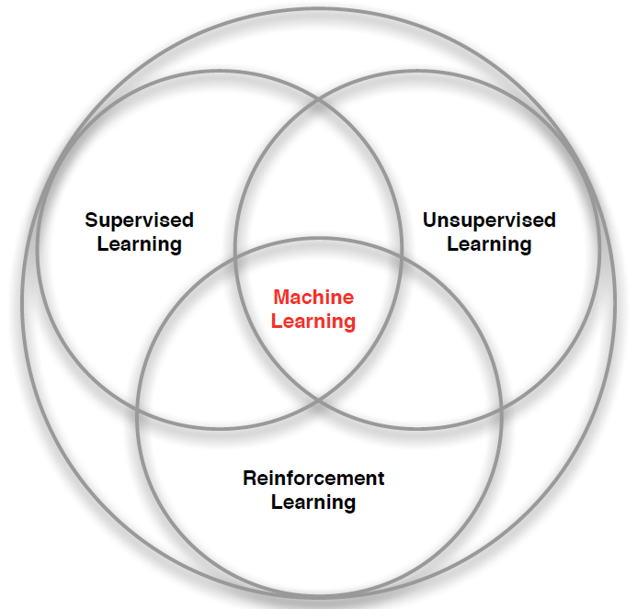
What is Reinforcement Learning?
Reinforcement learning is a kind of unsupervised supervised learning, so it combines aspects of the other two forms of machine learning.
Supervised Learning – Learn a function from labeled data that maps input attributes to an output.
Unsupervised Learning – Find classes, patterns or generalizations in unlabeled data.
Reinforcement Learning –An agent learns to maximize rewards while acting in an uncertain environment.
Credit: image borrowed from lecture slides David Silver, DeepMind, “Introduction to Reinforcement Learning

Slide 6

The Reinforcement Learning Problem
Agent
State: s’
Reward: r
Actions: a
Environment
Agent must learn to act to maximize expected rewards.
Agent knows the current state s, takes an action a, receives a reward r and observes the next state s’.
$S_{0}, A_{0}, R_{0},S_{1}, A_{1}, R_{2},S_{2}, A_{2}, R_{2},…,S_{n}, A_{n}, R_{n},S_{T}$
Agent has no access to the reward model r(s,a,s’) or the transition model T(s,a,s’).

Slide 7
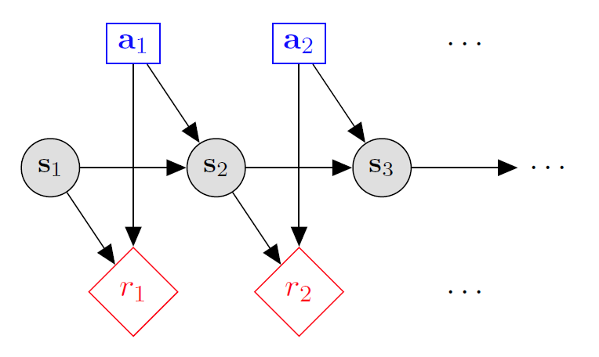

Markov decision processes
States: $s_{1},…,s_{n}$
Actions: $a_{1},…,a_{m}$
Reward model:
$R\left(s,a,s′\right)∈R$
Transition model:
$T\left(s,a,s′\right)=$ $P\left(s′ | s, a\right)$
Discount factor: $γ∈\left[0,1\right]$
<https://en.wikipedia.org/w/index.php?title=Markov_decision_process&oldid=855934986> [accessed 11 September 2018]

Slide 8
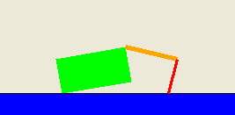
Application: Crawler robot
Arm
Location
Hand
States: <Location, Arm angle, Hand angle>
Actions: increase Arm angle, decrease Arm angle,
increase Hand angle, decrease Hand angle.
Reward model: +1 if robot moves right, -1 if robot moves left.
Transition model: model of box movement caused by arm movements.

Slide 9

The Discounted Return from An Episode
. . .
S₁
S₂
S₃
S_{T-1}
S_{T}
G₁
G₂
G₃
G_{T-1}
G_{T}

Slide 10
Quantities to optimize
The value (utility) of a state s:
V(s) = expected utility starting in s and acting optimally thereafter.
The value (utility) of a q-state (s,a):
Q(s,a) = expected utility when taking action a from state s and acting optimally thereafter.
The policy π:
π(a|s) = probability of action a from state s
s
s is a state
a
(s, a) is a q-state
s, a
s,a,s’
(s,a,s’) is a transition
s’
Credit: CS188 – Intro to AI, UC Berkeley, ai.berkely.edu
Notes:
Demo just shows V and Q values, snapshots on next slides.

Slide 11
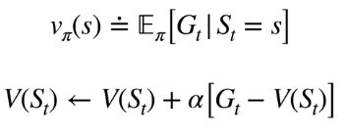
Computing the State-Value Function V from An Episode
. . .
S₁
S₂
S₃
S_{T-1}
S_{T}
G₁
G₂
G₃
G_{T-1}
G_{T}
Credit: Sample-based Learning Methods (M. White and A. White), University of Alberta, Alberta Machine Intelligence Institute, Coursera.

Slide 12
Computing the State-Value Function V from An Episode
Problem: We don’t know G_{t}
until the end of the episode.
. . .
S₁
S₂
S₃
S_{T-1}
S_{T}
G₁
G₂
G₃
G_{T-1}
G_{T}
Credit: Sample-based Learning Methods (M. White and A. White), University of Alberta, Alberta Machine Intelligence Institute, Coursera.

Slide 13
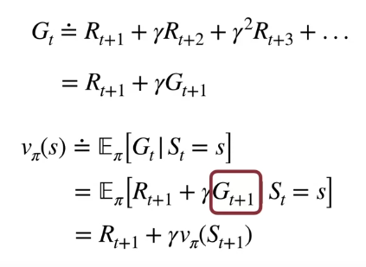

Expressing the State-Value Function Recursively
Credit: Sample-based Learning Methods (M. White and A. White), University of Alberta, Alberta Machine Intelligence Institute, Coursera.

Slide 14
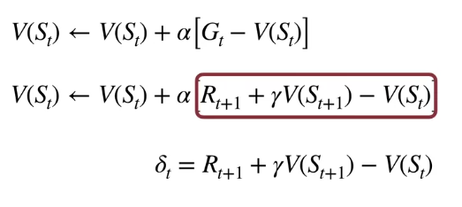
The Temporal Difference Error (TD-Error $δ_{t}$)
We can think of the value of the next state V(S_{t+1}) as a
stand-in for the return until the end of the episode.
Credit: Sample-based Learning Methods (M. White and A. White), University of Alberta, Alberta Machine Intelligence Institute, Coursera.

Slide 15

Updating from a Prediction
The TD-target
The TD-prediction
Credit: Sample-based Learning Methods (M. White and A. White), University of Alberta, Alberta Machine Intelligence Institute, Coursera.

Slide 16
$$S_{0}, A_{0}, R_{1},S_{1}, A_{1}, R_{2},S_{2},…,S_{t}, A_{t}, R_{t+1},S_{t+1}$$
Updating from a Prediction
. . .
S_{t}
S_{t+1}
. . .
V(S_{T})
V(S_{T}) ~ R_{T+1} + γV(S_{T+1})
Credit: Sample-based Learning Methods (M. White and A. White), University of Alberta, Alberta Machine Intelligence Institute, Coursera.

Slide 17
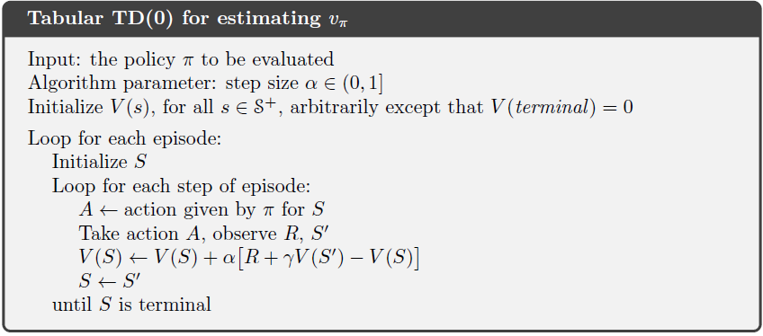

Temporal Difference Learning

Slide 18
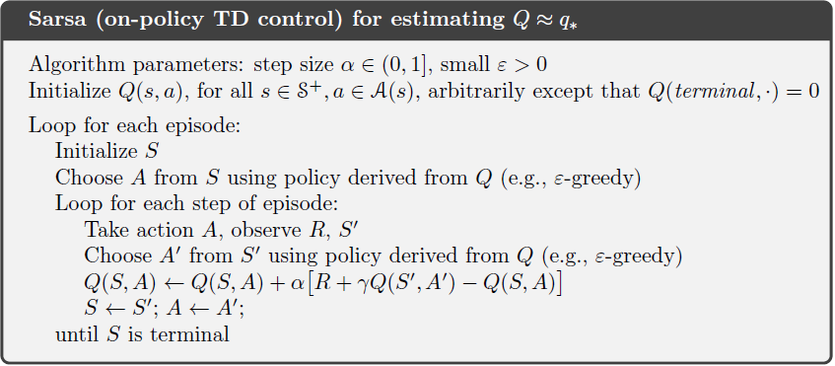

SARSA

Slide 19
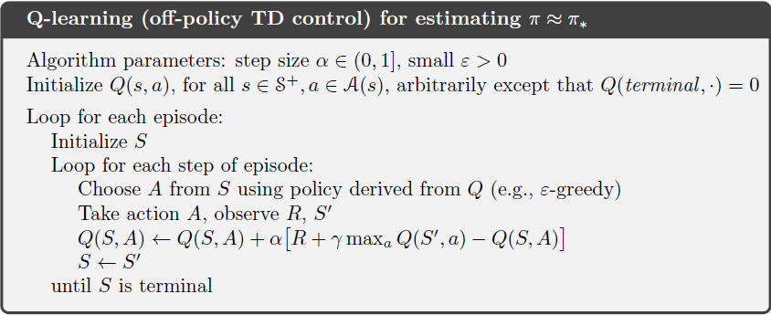
Q-Learning

Slide 20

Expected SARSA
Same as Q-Learning, but substitute expected state-action value for the max state-action value.

Slide 21
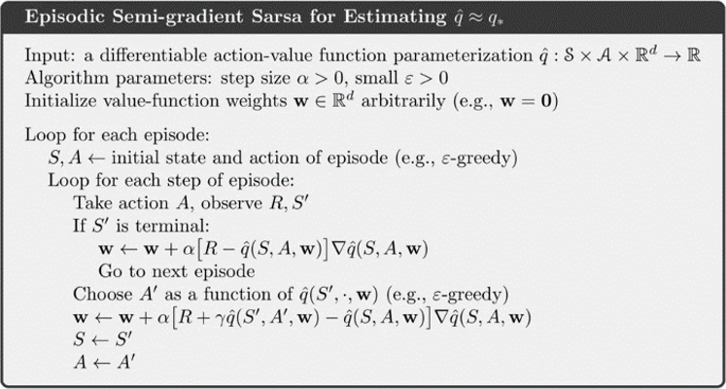
Episodic SARSA with Function Approximation
Credit: Reinforcement Learning: an Introduction, R. Sutton and A. Barto, 2018.

